Slide 1
WEDNESDAY, OCTOBER 12︎ ■ 3:00–4:00 P.M. (ET)

Slide 2
Speakers
Pierre Etienne
Internal Sales Manager–Northeast Division
Invesco
Yesenia Lankford
Assistant Vice President
Product Implementation
Jackson National
Courtney Lee
Associate Investment Strategist Dimensional Fund Advisors
Hammad Qureshi
Senior Economist
Investment Company Institute

Slide 3
Polling Question 1
I attend college in which of the following states/regions:
DC/Maryland/Virginia
Florida
Missouri
New England
New York/New Jersey
Texas
Other

Slide 4
Polling Question 2
What is your expected year of graduation?
2023
2024
2025
Other

Slide 5
Agenda
Introduction to ICI and the asset management industry
Career opportunities
  Investments
  Operations
  Sales and Marketing
A day in the life of an employee in asset management
Questions

Slide 6
ICI and Its Mission
ICI is the leading association representing regulated investment funds. Its mission is to strengthen the foundation of the asset management industry for the ultimate benefit of the long-term individual investor.

Slide 7
What Are Registered Funds?
Mutual Funds
Exchange-Traded Funds
Closed-End Funds
Unit Investment Trusts

Slide 8
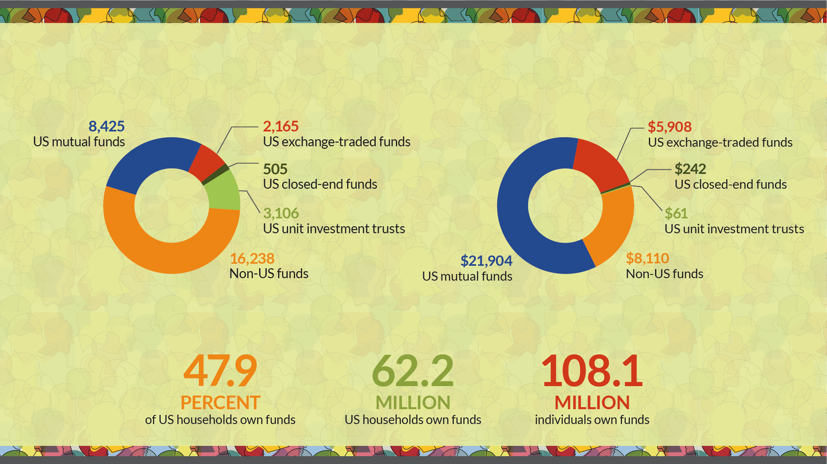
ICI Membership at a Glance
More Than 30,000 Funds
Number of investment companies by type*
With $36.2 Trillion in Assets
Investment company assets, billions of dollars*
Serving more than 100 million shareholders
US ownership of funds offered by investment companies*
* Data for ownership of funds are as of mid-2022.

Slide 9
Mutual Fund Contributions to the Economy
Mutual funds have made securities markets more accessible
  Mutual funds held about 23% of publicly traded US stock in 2021. All registered investment companies held 32%.
Money market funds lower cost of financing for businesses
Fund purchases of mortgage-backed securities lower costs of home ownership
Fund purchases of state and local government securities finance projects such as roads, bridges and hospitals

Slide 10
Asset Managers
Invest client money, acting as fiduciary, for a fee
  This allows clients to obtain professionally managed and diversified portfolios at a reasonable cost
Regulated as an “Investment Adviser”
  To protect investors, a fund’s investment adviser and the adviser’s employees are subject to numerous standards and legal restrictions
  Sound, strong regulation is critical to industry success!

Slide 11
Asset Management Clients
Individuals
Corporations and Banks
Retirement Plans and Trusts
Governments
Foundations and Endowments
Charities
Insurance Companies

Slide 12
CAREER PATHS & OPPORTUNITIES

Slide 13
A DAY IN THE LIFE

Slide 14
QUESTIONS?

Slide 15
Upload Your Resumé
Webinar participants are invited to upload their resumes to ICI’s Talent Connection Resumé Database.
ICI member firms will have access to the resumés and may contact participants directly regarding internship and job possibilities.

